Slide 1
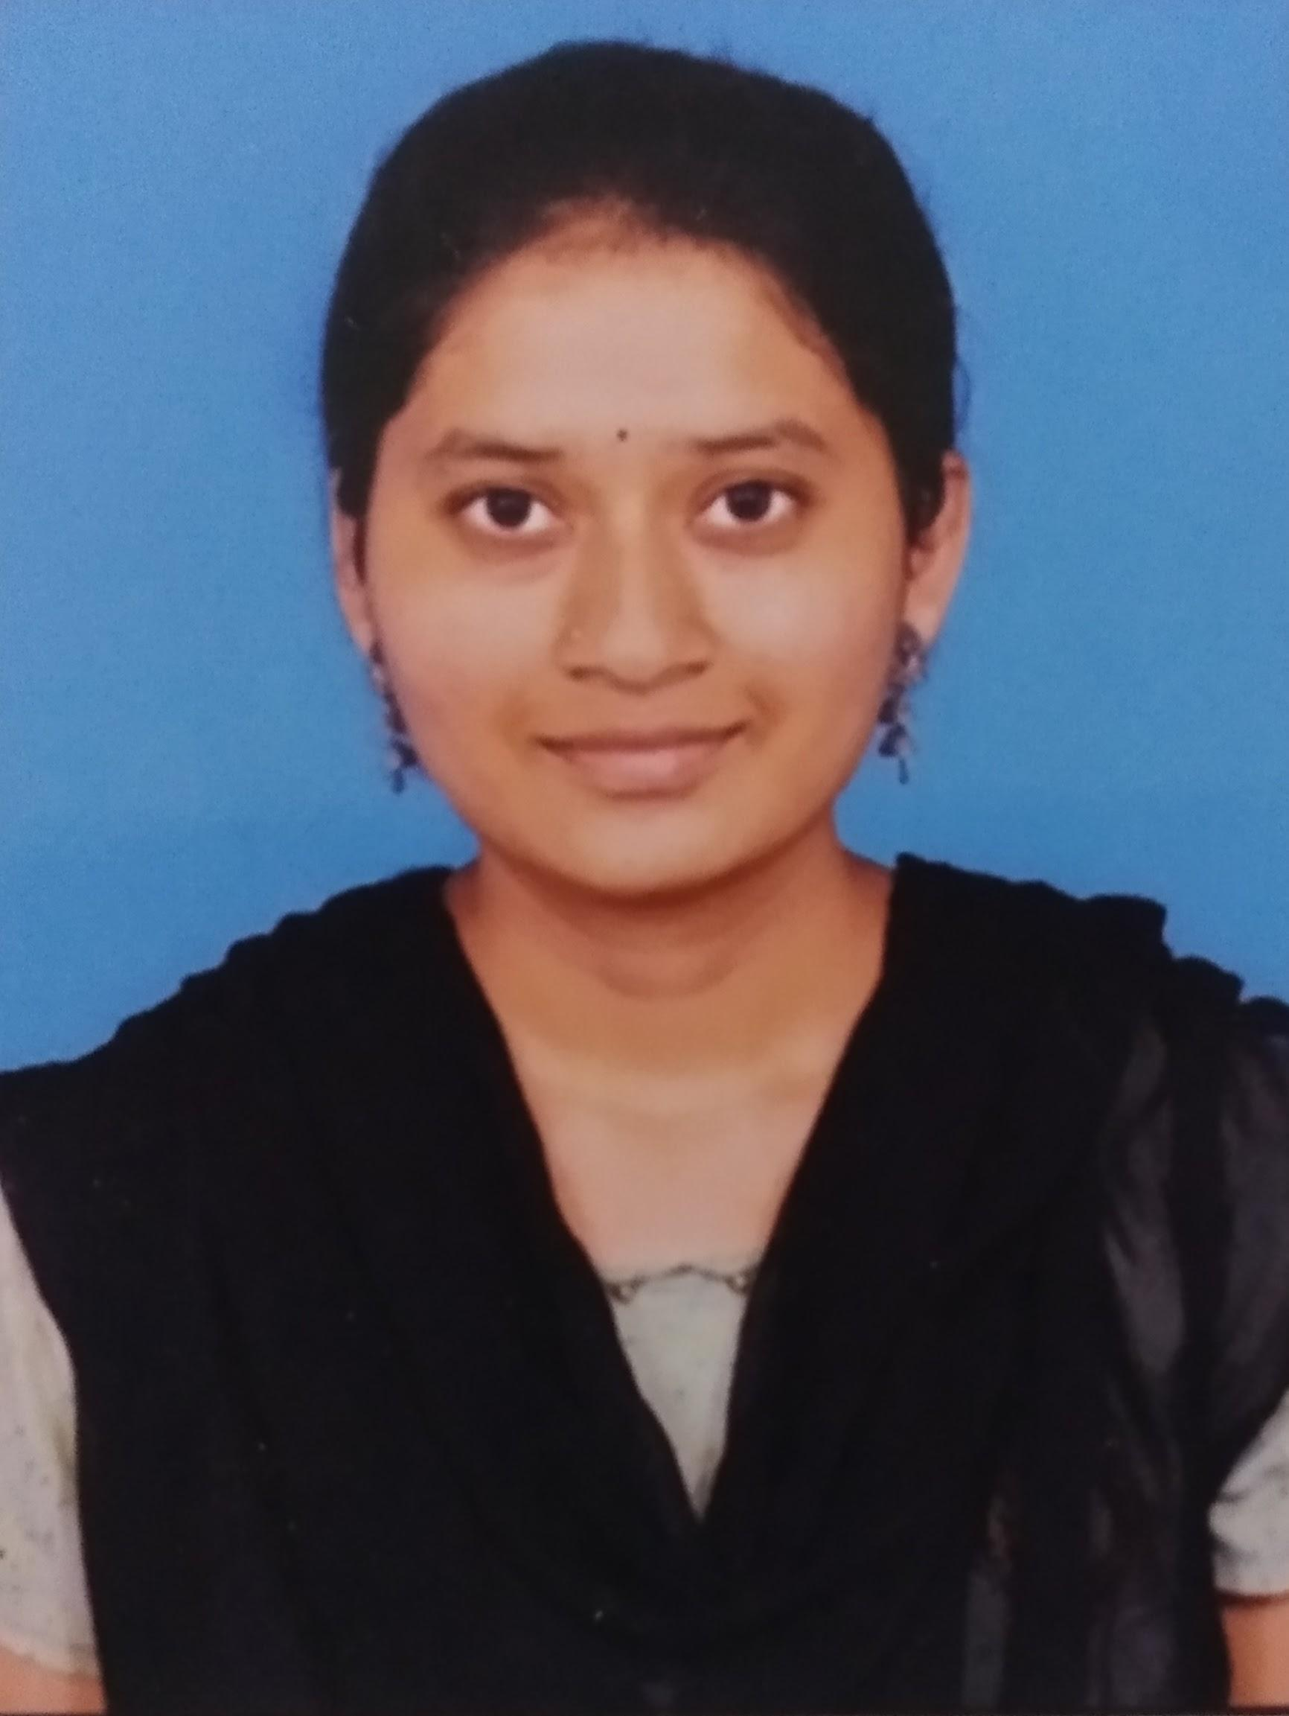
NAME : PAPPALA LEELADEVI
ROLL NO : 22X41A0493
COLLEGE NAME: SRK INSTITUTE AND TECHNOLOGY
COLLEGE STATE: ANDHRA PRADESH, VIJAYAWADA
SKILL BUILD ID : leeladevipappala@gmail.com
DOMAIN : CYBER SECURITY
START DATE : 3RD JUNE 2024
END DATE : 15TH JULY 2024

Slide 2
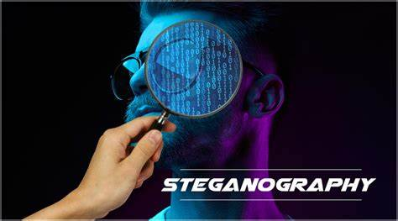
STEGANOGRAPHY
Steganography is the practice of concealing a message, image, or file within another message, image, or file to prevent detection. Unlike cryptography, which obscures the content of a message, steganography aims to hide the fact that a message even exists. This technique is often used in digital communications where information is embedded in digital media, such as images, audio files, or videos, in a way that is imperceptible to the human eye or ear. Steganography can be used for legitimate purposes, such as protecting intellectual property and ensuring privacy, but it can also be misused for illicit activities, such as hiding malicious software or secret communication. The field is continually evolving to counteract detection methods and enhance the robustness and capacity of hidden data.

Slide 3
AGENDA
1. Steganography and its primary goal of hiding information within other media to avoid detection.
2. Various types such as image, audio, video, and text steganography.
3. Key techniques like Least Significant Bit (LSB) insertion, masking and filtering, and transform domain methods (e.g., DCT, DWT).
4. Major challenges including detection issues, capacity limitations, robustness against media processing, security concerns, and algorithm complexity.
5. Applications such as digital watermarking, covert communication, and intellectual property protection.

Slide 4

OVERVIEW
"Hiding the Text in Image Using Steganography" focuses on embedding secret text messages within digital images in a way that is imperceptible to the human eye. This involves using techniques such as Least Significant Bit (LSB) insertion, where the binary data of the text is embedded into the least significant bits of the pixel values of the image. The primary goal is to ensure that the hidden text remains secure and undetectable while preserving the visual integrity of the image. The project will cover the design and implementation of the steganographic algorithm, testing the robustness of the hidden message against various image manipulations, and evaluating the effectiveness of the method in terms of security and capacity. This project has applications in secure communication, digital watermarking, and protecting intellectual property.

Slide 5
THE END USERS OF THIS PROJECT
1. Journalists and Whistleblowers:
- To securely share sensitive information without detection.
2. Intellectual Property Owners:
- To embed copyright information or digital watermarks in media files.
3. Government and Military Organizations:
- For secure and covert communication of classified information.
4. Corporate Sector:
- To protect proprietary data and communicate confidential information securely.
5. Individuals:
- For personal privacy and secure communication in everyday use.
6. Researchers and Academics:
- To study and develop advanced steganographic techniques for various applications.
7. Law Enforcement Agencies:
- To investigate and counteract the use of steganography for illegal activities.

Slide 6
SOLUTION AND ITS VALUE PROPOSITION
The project provides a steganographic solution for securely hiding text within digital images using techniques like Least Significant Bit (LSB) insertion. This approach involves embedding the binary data of the text into the least significant bits of the image's pixel values, ensuring that the hidden message is imperceptible to the human eye while maintaining the image's visual integrity.
1.Embeds text covertly within digital images using LSB insertion.
2.Ensures hidden messages are imperceptible yet securely embedded.
3.Preserves visual integrity of images while hiding text.
4.Provides secure communication and data protection.
5.Applicable in journalism, copyright protection, and secure communication sectors.

Slide 7
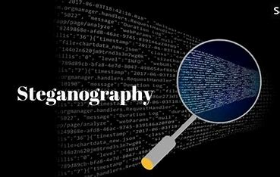
CUSTOMIZE THE PROJECT AND MAKE IT YOUR OWN
I integrated advanced encryption techniques to enhance message security and implemented robust error handling to ensure reliable data extraction. Additionally, I optimized the algorithm for faster embedding and extraction processes, tailored the user interface for intuitive operation, and conducted extensive testing to validate its effectiveness across various image formats

Slide 8

MODELLING
Creating a comprehensive steganographic model involved developing algorithms for embedding and extracting data within image files. This model integrated advanced encryption methods to ensure secure data hiding and devised mechanisms to handle potential errors during data extraction. Extensive testing was conducted to validate its efficiency across diverse image formats, ensuring both robustness and reliability in practical applications.

Slide 9
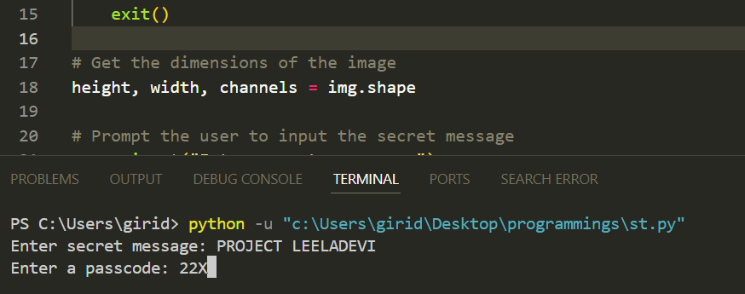

RESULTS

Slide 10
LINKS
https://github.com/Devi-1234-devi/Leela-project-

Slide 11
THANK YOU
LEELADEVI.PAPPALA

